Slide 1

AUTHENTICATION ADD-ON FOR SAGE 300
Modern single sign-on & multi-factor
authentication for Sage 300
Microsoft Entra SSO and Authenticator-app MFA — across Sage 300 Web Screens and Desktop, with no changes to Sage 300.
https://becait.com/products/sage300-authentication/ · info@becait.com

Slide 2
THE CHALLENGE
Sage 300 logins haven't kept up
Sage 300 still authenticates with a user ID and password. On its own, that no longer meets what security teams, auditors and cyber-insurers now expect.
Password-only access
Separate identities
Shared and reused passwords are the #1 cause of breaches — and Sage 300 has no built-in MFA.
Yet another credential to create, reset and offboard, disconnected from Microsoft 365.
Audit & compliance gaps
No safe add-on path
Hard to prove who logged in and enforce MFA / Conditional Access on the ERP.
Modifying Sage 300 risks upgrades and customisations — most teams just live with the risk.
BeCa IT Authentication for Sage 300
https://becait.com/products/sage300-authentication/

Slide 3
THE SOLUTION
Two functions, both Sage 300 UIs
BeCa IT Authentication is a drop-in module that adds modern sign-in to Sage 300 — use single sign-on, multi-factor, or both layered together.
SSO — Single sign-on
MFA — Multi-factor authentication
Adds “Sign in with Microsoft” to Sage 300. People log in with the Microsoft work account they already use.
Adds a 6-digit Authenticator code on top of the user’s normal Sage 300 credentials.
• Microsoft Entra ID (OpenID Connect)
• Extensible to Google & other OIDC providers
• Web Screens & Desktop
• TOTP — RFC 6238
• Microsoft / Google Authenticator, Authy…
• Web Screens & Desktop
BeCa IT Authentication for Sage 300
https://becait.com/products/sage300-authentication/

Slide 4
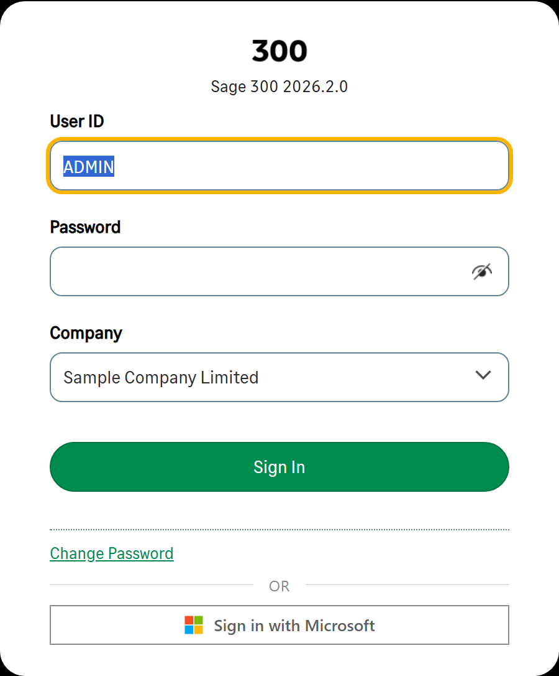
FUNCTION A · SSO
Single sign-on with Microsoft Entra ID
✓ One click. Users sign in with their existing Microsoft 365 account — no separate Sage 300 password.
✓ Central control. Disable a user in Entra ID and their Sage 300 access ends immediately.
✓ Policies carry over. Your Microsoft MFA and Conditional Access automatically apply to Sage 300.
✓ True identity. Each person lands as their own Sage 300 user — permissions & audit preserved.
✓ Web & Desktop. Works in both, and extends to Google and other OpenID Connect providers.
BeCa IT Authentication for Sage 300
https://becait.com/products/sage300-authentication/

Slide 5
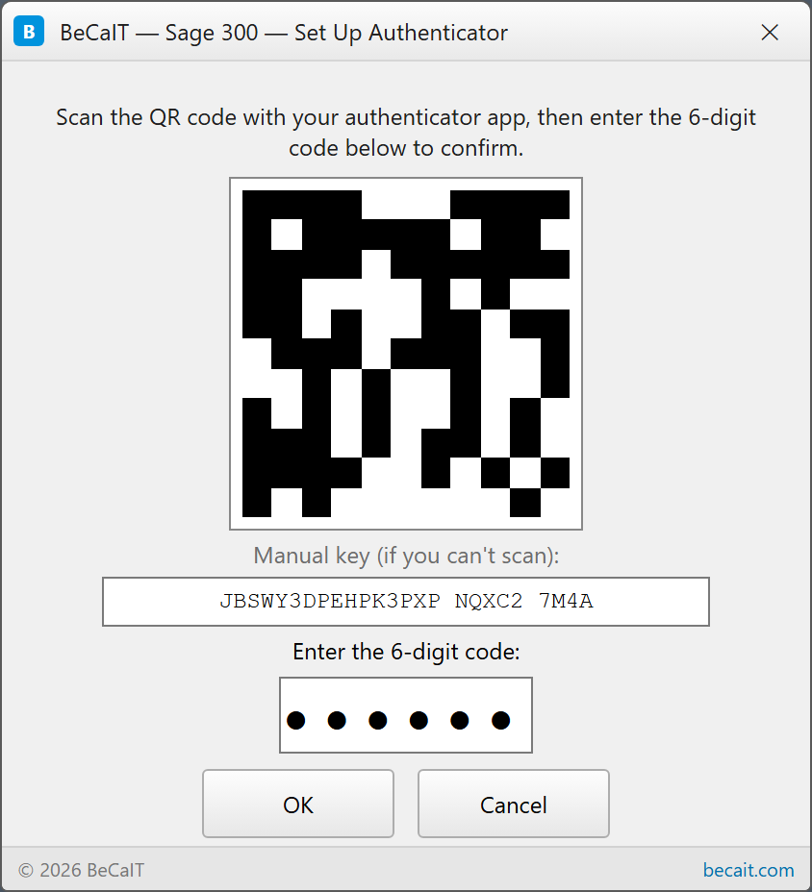
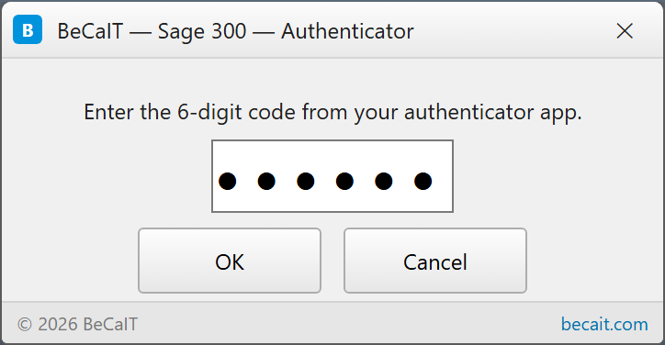
FUNCTION C · MFA
Multi-factor with an Authenticator app
✓ Enrol once. Scan a QR code with Microsoft or Google Authenticator, Authy and others.
✓ Code at sign-in. Enter a fresh 6-digit time-based code — auto-submits when complete.
✓ Standards-based. TOTP (RFC 6238), fully offline — no SMS fees, no extra hardware.
✓ Layered. Sits on top of single sign-on or the normal Sage 300 password.
✓ Web & Desktop. The same simple prompt wherever your team signs in.
BeCa IT Authentication for Sage 300
https://becait.com/products/sage300-authentication/

Slide 6
HOW IT WORKS
A transparent layer in front of Sage 300’s sign-in
Verify the user
Entra ID (SSO) · Authenticator (MFA)
BeCa IT Authentication
drop-in layer · intercepts sign-in only
Sage 300
Web & Desktop
Sage 300 sign-in
all other calls pass straight through
A pure interceptor. Every call passes straight through to Sage 300’s own authentication — except the sign-in check, where SSO or MFA is added. Nothing else in Sage 300 is touched, so upgrades and customisations keep working.
BeCa IT Authentication for Sage 300
https://becait.com/products/sage300-authentication/

Slide 7
SECURITY
Built on open standards — your data stays in Sage
✓ Open standards. OpenID Connect / OAuth 2.0 for SSO and TOTP (RFC 6238) for MFA — no proprietary lock-in.
✓ Your data stays in Sage. Settings and enrolment live inside your own Sage 300 database. No third-party cloud account; no data leaves your environment.
✓ No Sage 300 changes. A pure interceptor that forwards everything else untouched — safe across Sage upgrades.
✓ Per-function licensing. License SSO, MFA, or both — validated locally; gentle in-product expiry reminders.
✓ Safe to remove. Uninstalling cleanly restores Sage’s original sign-in. No leftovers, no lock-in.
✓ Built by your Sage partner. A recognised Sage 300 (Accpac) partner since 2006 — support that understands both Sage and security.
BeCa IT Authentication for Sage 300
https://becait.com/products/sage300-authentication/

Slide 8
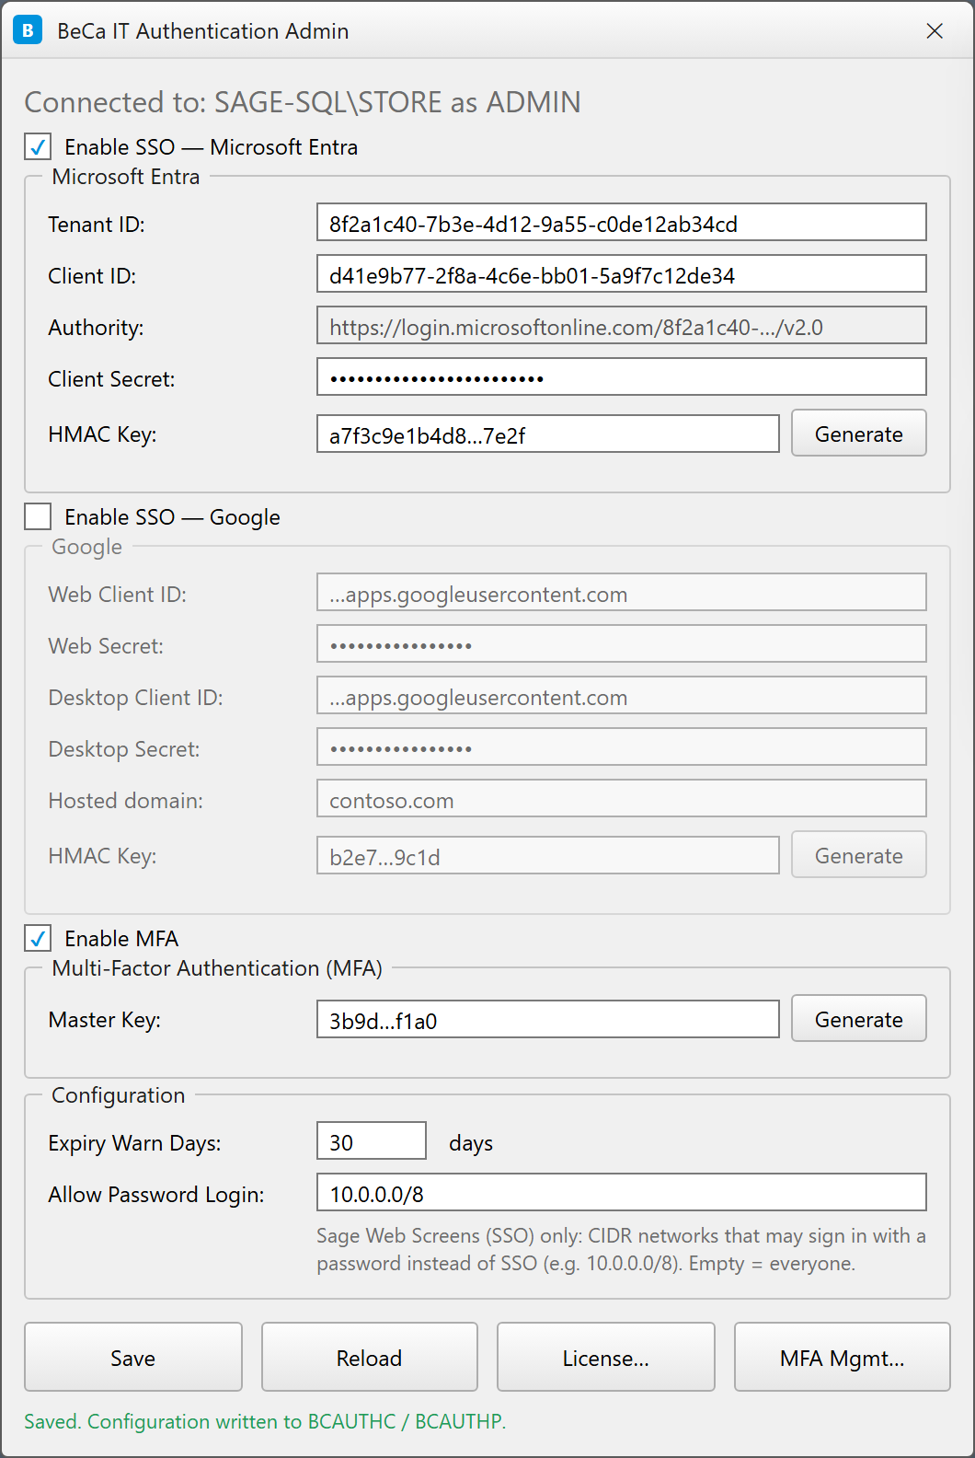
CENTRALLY MANAGED
Point-and-click setup with the Admin tool
✓ Enable per provider. Turn on Microsoft Entra, Google, or MFA with a checkbox.
✓ Paste your tenant settings. Tenant ID, Client ID and secret; the authority is derived for you.
✓ One-click key generation. Generate HMAC and MFA master keys in place.
✓ Set policy. Licence-expiry reminders and an optional password-login allowlist by network.
✓ Manage enrolments. Review and reset users’ MFA from one screen.
BeCa IT Authentication for Sage 300
https://becait.com/products/sage300-authentication/

Slide 9
DEPLOYMENT
Minutes to deploy — matched to your Sage version
1
2
3
Install
Configure
Sign in
Run the BeCa IT installer matched to your exact Sage 300 Product Update. It slots in beside Sage 300 — no new servers.
Open the Admin tool, enable SSO and/or MFA, and paste your Microsoft Entra settings.
Your team clicks “Sign in with Microsoft” or enters their Authenticator code — on Web and Desktop.
Supported Sage 300 versions: 2025 PU5 and 2026 PU2 — new Product Updates added as they ship.
BeCa IT Authentication for Sage 300
https://becait.com/products/sage300-authentication/

Slide 10
Give Sage 300 the login security
your customers already expect.
✓ Stronger sign-in instantly — SSO + MFA on Web and Desktop
✓ Zero disruption — no Sage 300 changes, no new servers
✓ Everyone keeps their own Sage 300 identity and audit trail
Talk to us: info@becait.com · +84 1900 1509
https://becait.com/products/sage300-authentication/

